Slide 1
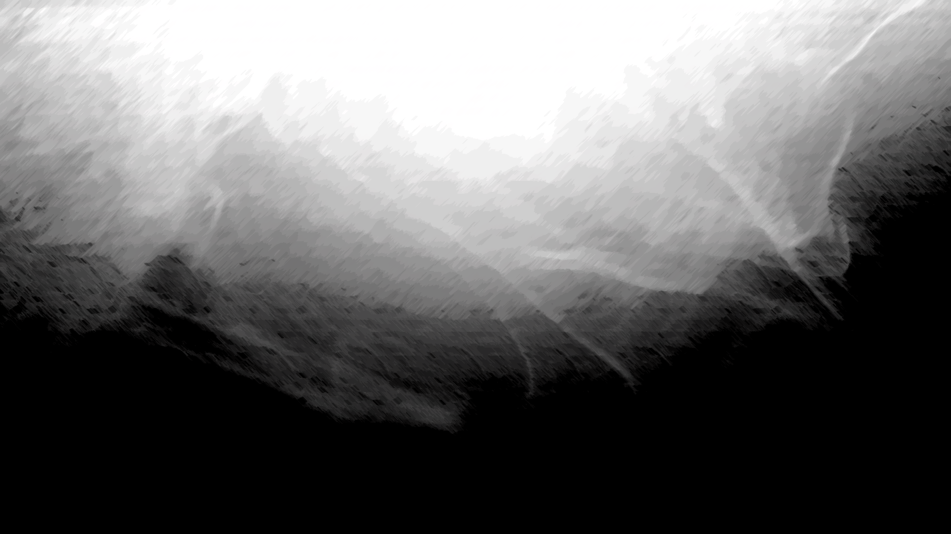
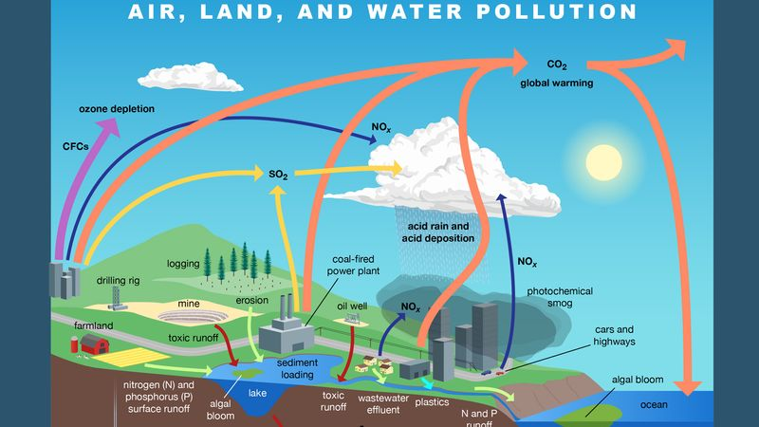
pollution
What is Pollution
Pollution is the introduction of substances or energy (such as light or heat) into the natural environment in amounts or concentrations that can be harmful for humans, animals, and plants.
Pollution can reduce the health of ecosystems by harming or even causing death to the living things that call those ecosystems home. The negative effects of pollution can range in severity depending on what the pollutant is, the characteristics of the pollutant, and where the pollutant is located.

Slide 2
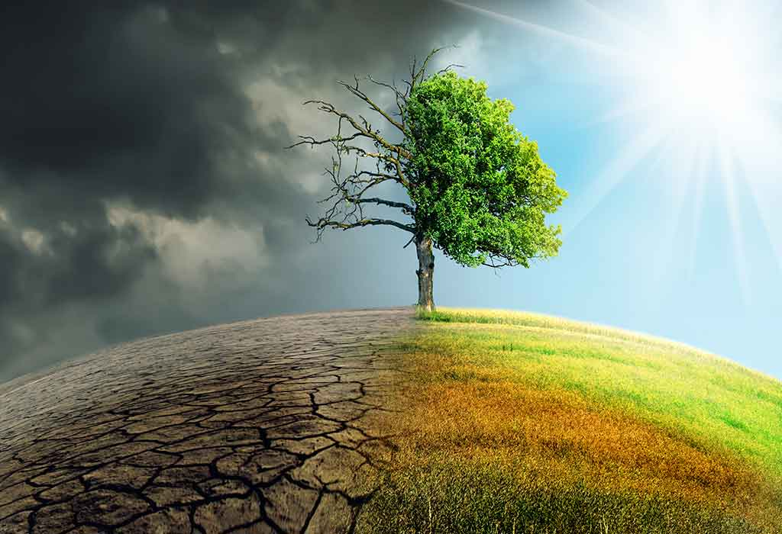
Pollution is most often composed of synthetic, or human-made substances (like plastic, for example), although even natural substances like sediment, nutrients, and carbon dioxide can become pollutants when they exceed a particular level. If natural substances exceed healthy levels, however, it is very likely the result of human activities.
The way in which pollution is categorized, studied, and managed depends on what Earth system is affected. Parts of Earth’s systems that can be affected by pollution include land, waterways (such as ground-water, rivers, lakes, bays, and oceans), air, and climate. What are some different types of pollution?

Slide 3
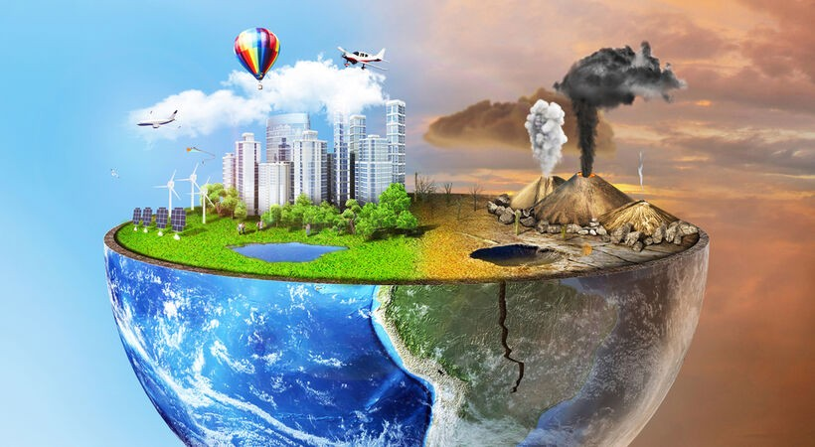
What are some different types of pollution?
Water, air, and land pollution are three major categories of pollution. Sometimes pollution is easy to detect and is obvious to see, like an oil spill from a ship in the ocean. However, pollution can also be hard to see, like in the case of many types of air pollution. Specific pollutants can also contaminate more than one system at a time. For example, spilled chemicals may contaminate soil at the spill site (land pollution), and rain water may carry the chemicals and some of the contaminated soil into waterways (water pollution).
Land pollution can be anything from litter on the streets to spilled chemicals, such as gasoline in a gas station parking lot. A large portion of land pollution comes from industrial waste, which is generated from manufacturers or factories. It can also come from commercial waste produced by businesses, such as plastic food wrappers.

Slide 4
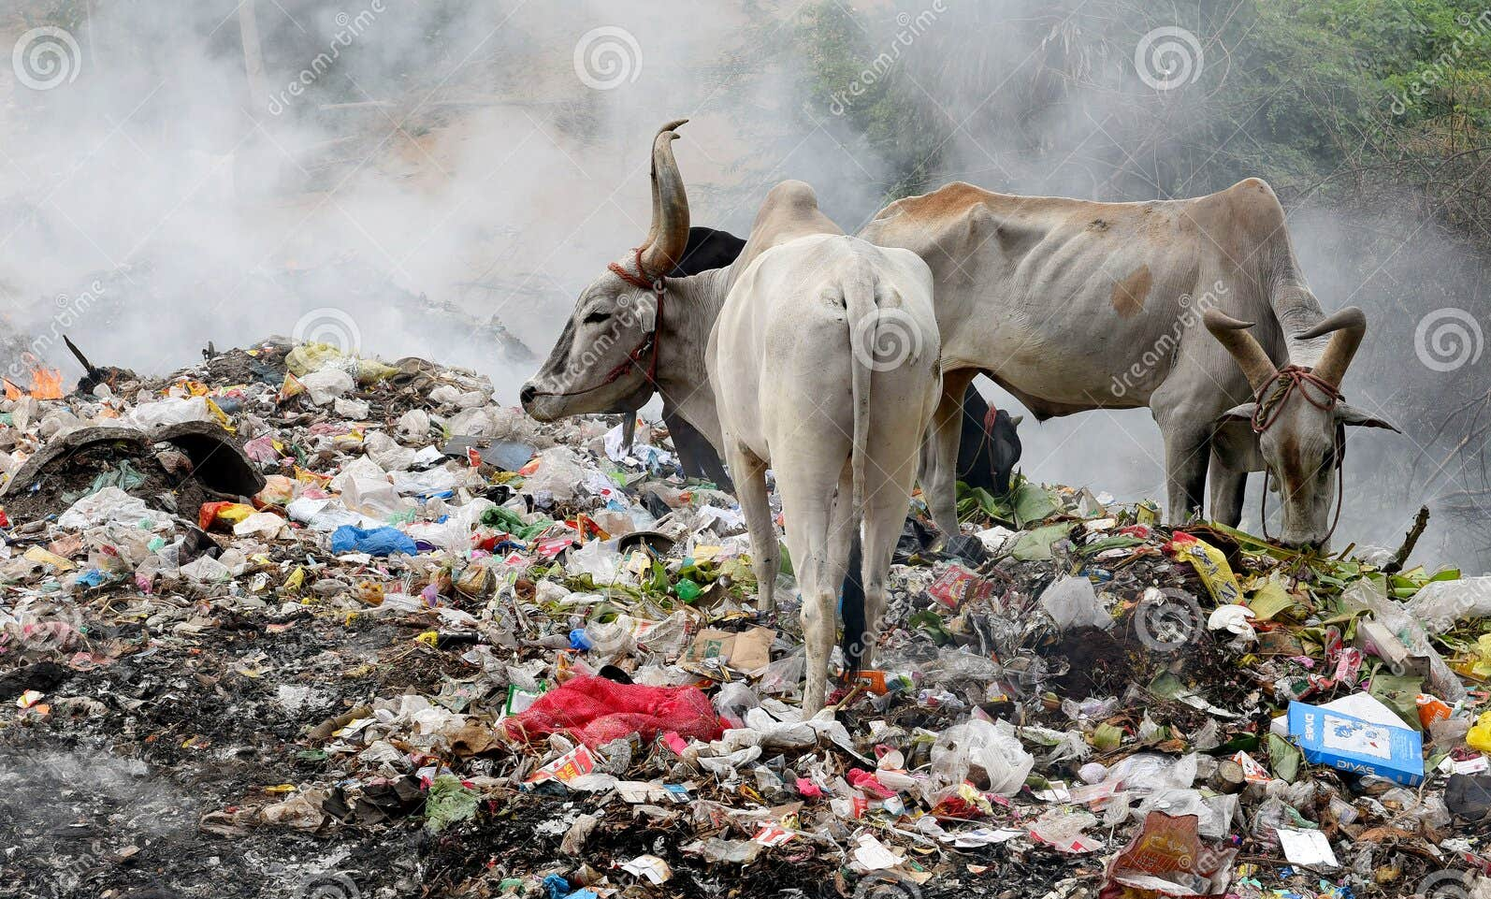
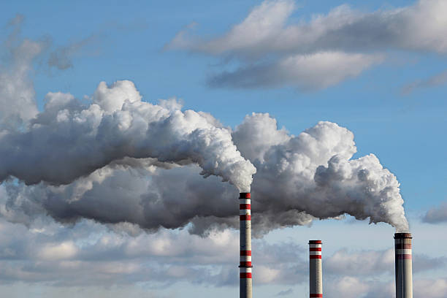
Another common source of land pollution is solid waste, such as household garbage. The garbage, or trash, that we generate includes things like food packaging, food waste, personal care products, and other unwanted items.
Land pollution can become water or air pollution. In fact, most of the pollution in the ocean comes from sources on land! One major way that this happens is through runoff, when rain or wind washes pollutants off the land and into storm drains or waterways. As the runoff travels, it picks up any pollutants in its path like trash and chemicals. Once in storm drains, the polluted runoff can then enter streams, rivers, and eventually bays and the ocean. Types and environmental impacts
Air Pollution is a mixture of gases and solid particles in the air. Air pollution comes from the exhaust that cars and trucks produce when they burn gasoline for fuel, chemicals from factories, dust, mold, smog, and other sources. Air pollution can reach harmful concentrations both outside and indoors.

Slide 5
What are the effects of pollution on the environment and living things?
Pollution harms the environment by making it less suitable for living things. Sometimes a pollutant is toxic or dangerous and can directly cause living things to die. However, lower amounts of a pollutant or different types of pollutants may make a living thing sick, cause injury, or reduce its ability to find good habitat or food.
Pollutants can be especially dangerous when they accumulate, or build up, in an ecosystem and reach high, toxic concentrations. Plants and animals can absorb or ingest toxins from pollution, which can be damaging to their own health. As organisms eat each other, toxins from the pollution can then be passed from organism to organism up the food chain, increasing in concentration each time until they are at such high levels that they can cause death or serious health problems to the organism. Air pollution can be very dangerous to the animals and humans who breathe it in. It can cause short-term issues such as sneezing or coughing as well as long-term problems such as disease and even death.

Slide 6
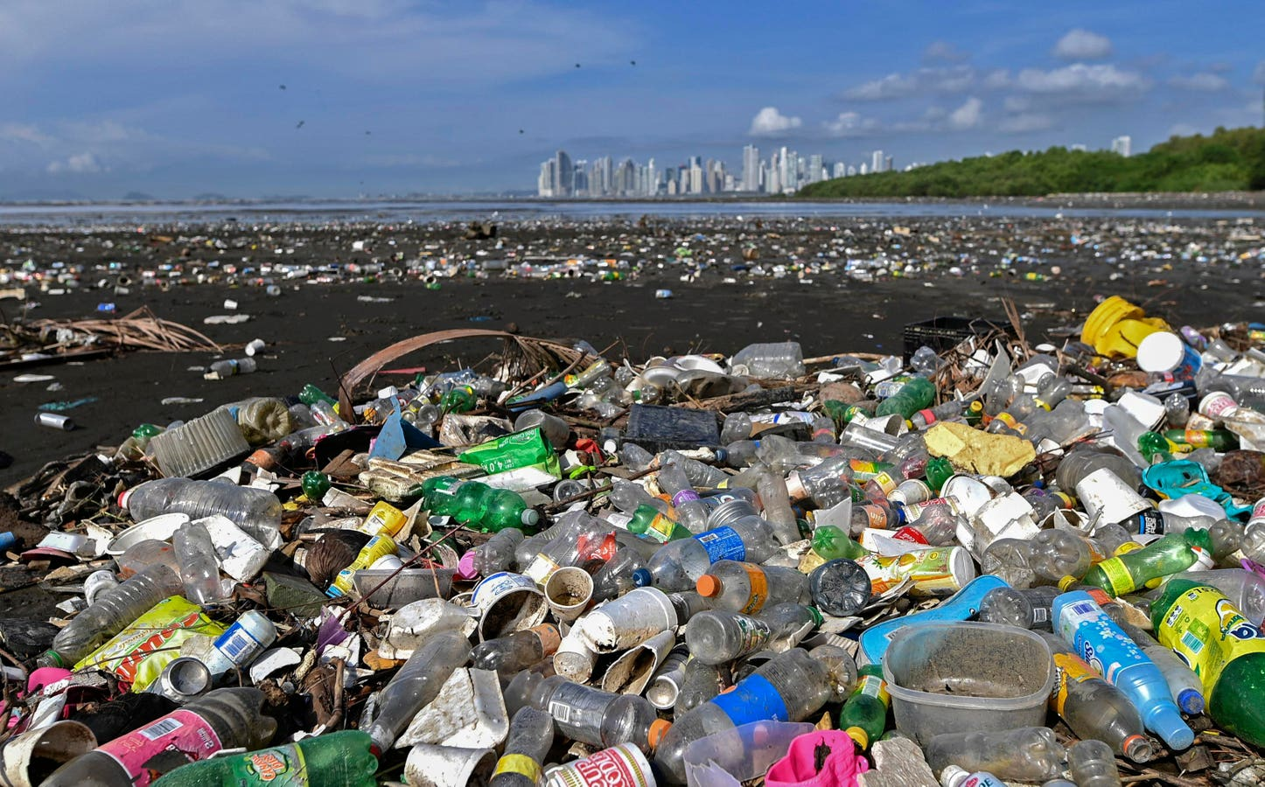
What is plastic pollution?
Much of the solid waste that becomes land and water pollution is made of plastic. There are
many properties of plastic pollution that make it dangerous to natural environments. Items made of plastic (like plastic bags and bottles) are lightweight and float, which makes it easy for them to travel by wind and water into the environment. Because plastic is very durable and it can withstand damage, plastics can remain in ecosystems for years and years. As pollution, plastic can injure animals if they become entangled in it (for example, if an animal gets tangled in an abandoned plastic nylon fishing net) or if animals ingest plastic because they mistake it for food. What can you do to help?

